Slide 1

FoodHub Data Analytics Project
Executive Summary
Business Problem Overview and Solution Approach
Data Overview
EDA - Univariate Analysis
EDA - Multivariate Analysis
Conclusions and Recommendations

Slide 2

Executive Summary
Project Overview:
FoodHub, an online food aggregator requested to analyze
customer order data to optimize restaurant partnerships,
delivery efficiency, and customer satisfaction.
Key Findings:
Cuisine Demand: American, Japanese, and Italian cuisines are the most ordered.
Delivery Impact on Ratings: Faster deliveries lead to higher customer ratings.
Revenue Insights: Shake Shack is the top revenue-generating restaurant ($3,579.53).
Weekday vs. Weekend Trends: Deliveries are faster on weekends than weekdays.
Business Recommendations:
✅ Optimize slow delivery restaurants to improve customer satisfaction.
✅ Leverage high-performing restaurants with targeted promotions.
✅ Incentivize customer ratings to gather valuable feedback.
✅ Expand meal bundle options to drive higher revenue.
📈 Outcome: By implementing these strategies, FoodHub can enhance customer experience, streamline operations, and maximize profitability.

Slide 3

Data Analysis - Overview
KEY FINDINGS | DETAILS
Cuisine Popularity & Demand Trends | Certain cuisine types (e.g., American, Japanese, and Italian) receive highest number of orders. Restaurant popularity varies, with a few establishments receiving a disproportionate order count
Ratings & Customer Choices | Orders with higher ratings indicate better customer satisfaction, suggesting that restaurants with consistently lower ratings may need to improve food quality or service. A significant portion of orders lacks ratings ("Not given"), making it harder to evaluate customer sentiment comprehensively.
Cost & Order Volume | Orders priced between $10–$30 dominate, indicating an optimal price range for customer preferences. Higher-cost orders ($30+) are less frequent but may be associated with premium restaurants.
Delivery & Prep Efficiency | A direct correlation between food preparation time and delivery time suggests that longer preparation leads to delays. Some restaurants consistently have longer delivery times, affecting customer experience.
Weekday vs. Weekend Trends | Higher order volumes on weekends, suggesting increased demand during leisure time. Delivery times tend to be longer on weekdays.

Slide 4

Areas of Improvement
AREA | SUGGESTIONS
Leverage Cuisine Demand Data for Partnerships | Increase partnerships with high-demand cuisine types to meet customer preferences. Introduce targeted promotions for underperforming cuisine types.
Optimize Restaurant & Delivery Performance | Work with restaurants that have long preparation times to streamline operations. Use delivery time insights to adjust logistics and improve efficiency.
Improve Customer Feedback Collection | Encourage customers to rate orders to get a better understanding of satisfaction levels. Offer incentives (discounts, loyalty points) for leaving feedback.
Adjust Pricing Strategies | Ensure that affordable price points ($10–$30) remain a focus. Consider introducing bundle deals or loyalty rewards for higher-priced orders.
Weekend Order Management | Allocate more delivery resources on weekdays to maintain efficiency. Encourage pre-orders to reduce peak-hour congestion.

Slide 5

Business Problem Overview
FoodHub, an online food aggregator, aims to enhance customer experience and optimize business operations by analyzing its order data. The company wants to understand:
Which cuisine types and restaurants are most in demand.
How cost, ratings, and delivery times impact customer satisfaction.
The efficiency of food preparation and delivery logistics.
How order trends vary by day of the week.
By addressing these questions, FoodHub seeks to improve restaurant partnerships, streamline deliveries, and boost customer retention.

Slide 6

Solution Approach to Address Business Goals
METHODOLOGY | SOLUTION DETAILS
Data Collection & Understanding | Dataset containing 1898 food orders was reviewed. Key attributes include order cost, delivery time, ratings, cuisine type, and restaurant name.
Data Cleaning & Preprocessing | Missing ratings labeled as "Not given". Data types validated for accuracy. Outliers in cost and time-related features assessed.
Exploratory Data Analysis (EDA) | Identified popular cuisines & restaurants. Analyzed order cost distribution to understand pricing trends. Examined food preparation and delivery times to assess efficiency. Studied customer ratings to gauge satisfaction levels.
Business Insights & Visualization | Created charts and tables to identify demand trends. Mapped relationships between order cost, delivery time, and ratings. Compared weekday vs. weekend order patterns.
Business Recommendations | Leverage Cuisine Demand Data for Partnerships, Optimize Restaurant & Delivery Performance, Improve Customer Feedback Collection, Adjust Pricing Strategies, Weekend Order Management

Slide 7

Data Overview
DESCRIPTION | FINDINGS
Data set size | Rows = 1898, Columns = 9
Datatypes in dataset | dtypes: float64(1), int64(4), object(4) int64: order_id, customer_id, food_preparation_time, delivery_time object: restaurant_name, cuisine_type, day_of_the_week, rating float64: cost_of_the_order
Missing values and their treatment | In the Ratings column there were missing ratings marked as “Not given”. All other columns had values.
Statistical summary of the data | Stats for food_preparation_time are: min = 20, max = 35, average = 27.37
Other important observation | 736 orders are not rated.

Slide 8
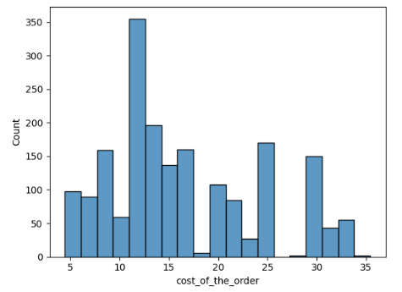
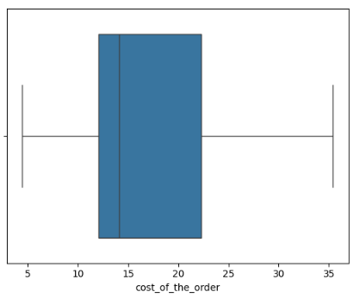
Univariate Analysis - Numeric Variables 1/3
Univariate analysis explores all variables and provides observations on their distributions.
Variable | Histogram | Boxplot | Observation
Cost of the order |  |  | The distribution is right-skewed, with most orders falling between $10–$30. A few high-cost orders act as outliers.

Slide 9
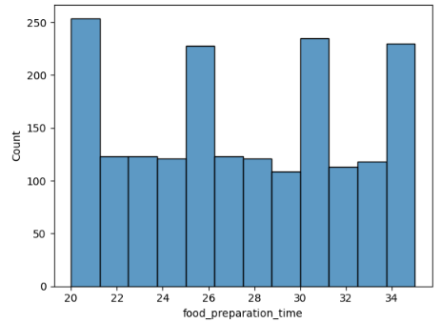
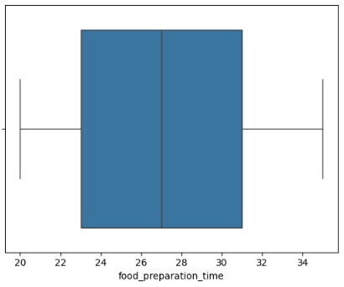
Univariate Analysis - Numeric Variables 2/3
Variable | Histogram | Boxplot | Observation
Food Preparation Time |  |  | Most orders take 20–30 minutes to prepare. The average preparation time is ~27 minutes, with a maximum of 35 minutes.

Slide 10
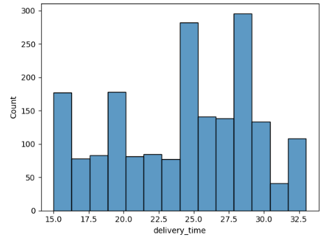
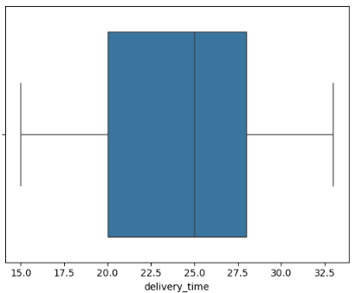
Univariate Analysis - Numeric Variables 3/3
Variable | Histogram | Boxplot | Observation
Delivery Time |  |  | The majority of deliveries fall within 15–30 minutes. There are a few cases where delivery times are significantly longer, likely due to outliers.

Slide 11
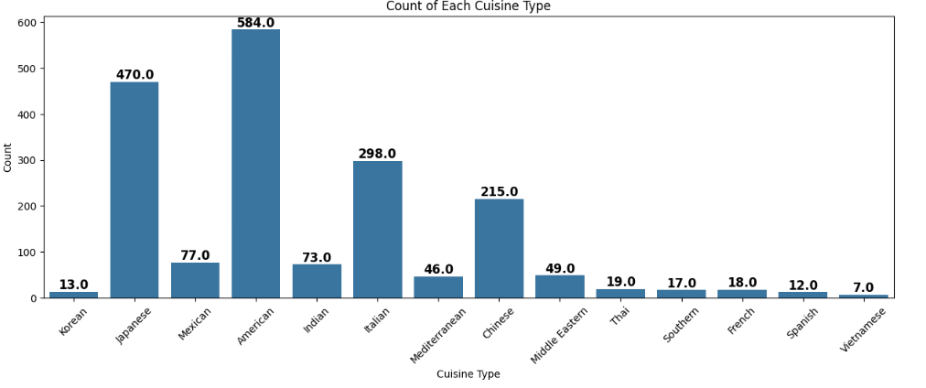
Univariate Analysis - Categorical Variables 1/3
Variable | Observation
Cuisine Type | Certain cuisine types (e.g., American, Japanese, and Italian) are ordered more frequently. Other cuisines have significantly fewer orders.

Slide 12
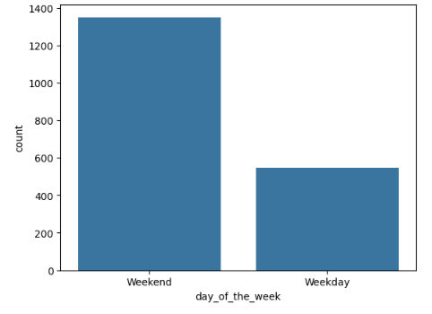
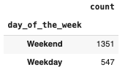
Univariate Analysis - Categorical Variables 2/3
Variable | Observation
Day of the Week | Orders are higher on weekends compared to weekdays. Indicates increased demand for food delivery on weekends.

Slide 13
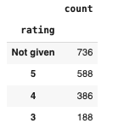
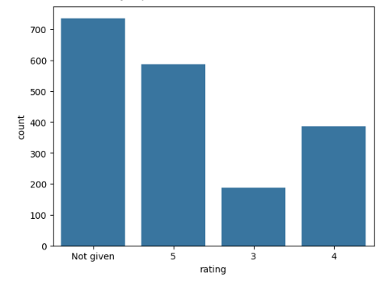
Univariate Analysis - Categorical Variables 3/3
Variable | Observation
Rating | A large portion of ratings is "Not Given", meaning missing feedback. Among available ratings, 4 and 5 stars are most common, indicating overall positive customer satisfaction.

Slide 14
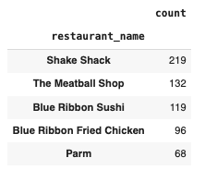

Univariate Analysis - Top 5 Restaurants with Highest Orders

Slide 15
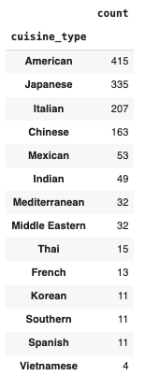

Univariate Analysis - Most Popular Cuisine Per Order
Count on Weekends

Slide 16

Univariate Analysis - Orders > $20 in Value
The number of total orders that cost above 20 dollars is: 555
Percentage of orders above 20 dollars: 29.24 %

Slide 17

Univariate Analysis - Mean Delivery Time
The mean delivery time for this dataset is 24.16 minutes

Slide 18
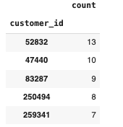

Univariate Analysis - Top 5 Most Frequent Customers

Slide 19
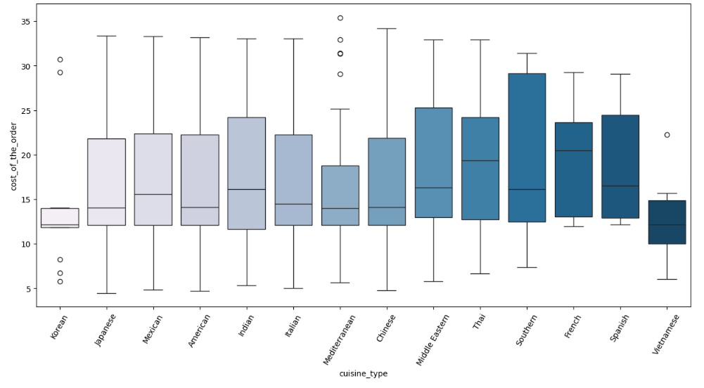
Multivariate Analysis - Cuisine vs Cost of the order
High-cost cuisines: French cuisine has the highest median order value..
Affordable cuisines: Ignoring the outliers, Korean and Vietnamese cuisines are with lowest median order costs.
Outliers: Some orders, especially in Korean and Mediterranean cuisines, are significantly higher in price.

Slide 20
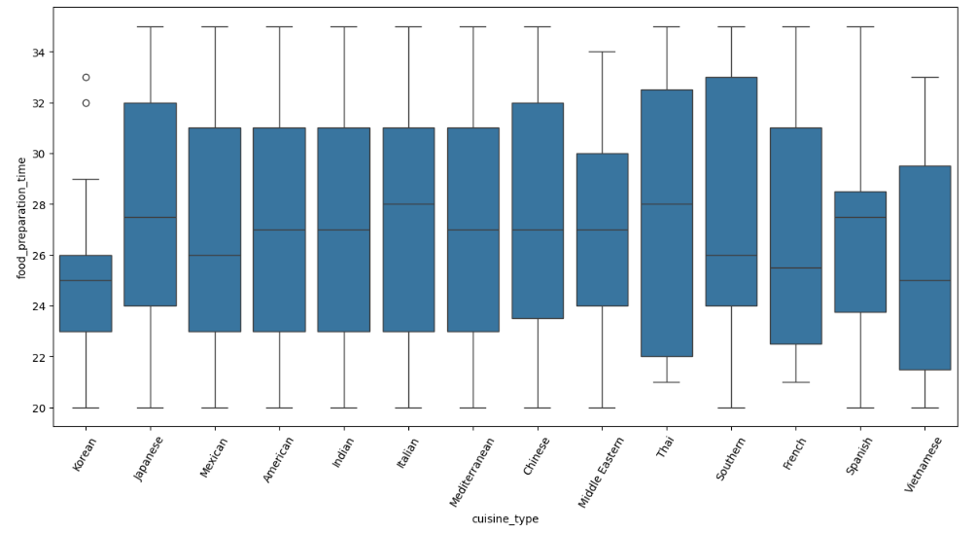
Multivariate Analysis - Cuisine vs. Food Preparation Time
Italian, Thai, and Spanish foods have highest median prep time, while Korean and Vietnamese have the least.
Thai and Southern cuisines have the highest Q3 values.
Korean cuisine has the fastest preparation time with 75% of orders getting prepared in 26 minutes or less.

Slide 21
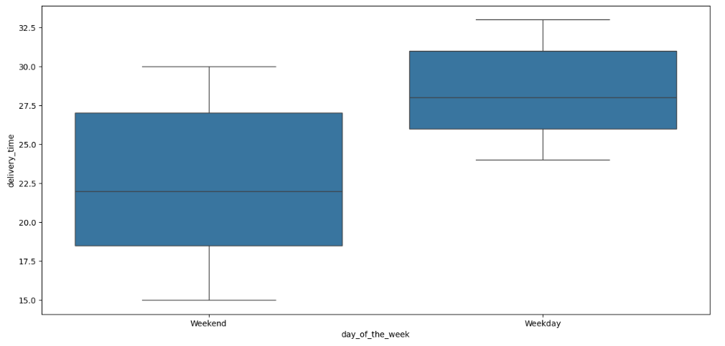
Multivariate Analysis - Day of the Week vs Delivery time
Weekday deliveries take longer.
More variation in delivery time on weekends, leading to inconsistent service.
Weekday deliveries are slower but more consistent.

Slide 22
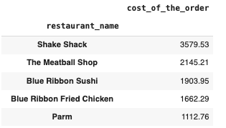

Multivariate Analysis - Top 5 Revenue Generating Restaurants

Slide 23
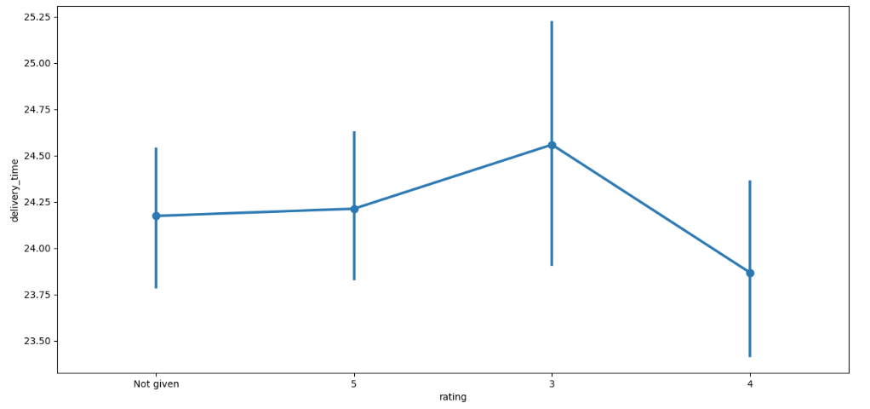
Multivariate Analysis - Rating vs Delivery time
Higher ratings (4 and 5) are linked to shorter delivery times, indicating that faster deliveries improve customer satisfaction.
Lower ratings are associated with longer delivery times, suggesting delayed orders lead to poor reviews.
Reducing the delivery time can positively impact ratings.

Slide 24
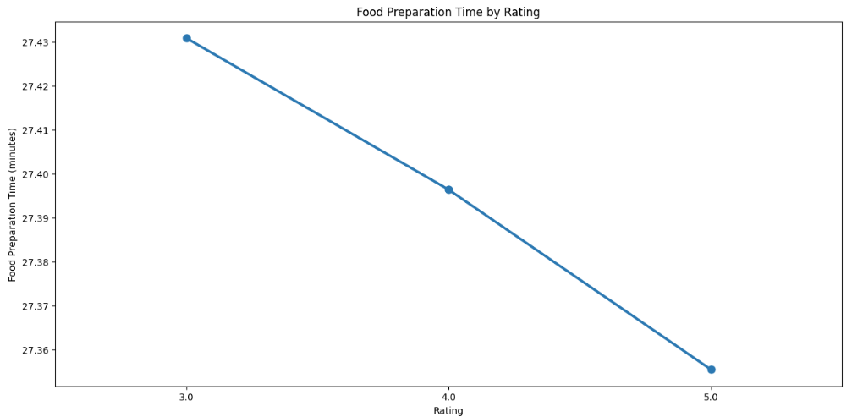
Multivariate Analysis - Rating vs Food preparation time
Faster food preparation leads to higher ratings, while longer prep times correlate with lower ratings.
Customers prefer quicker service, as seen in the downward trend of prep time with increasing ratings.

Slide 25
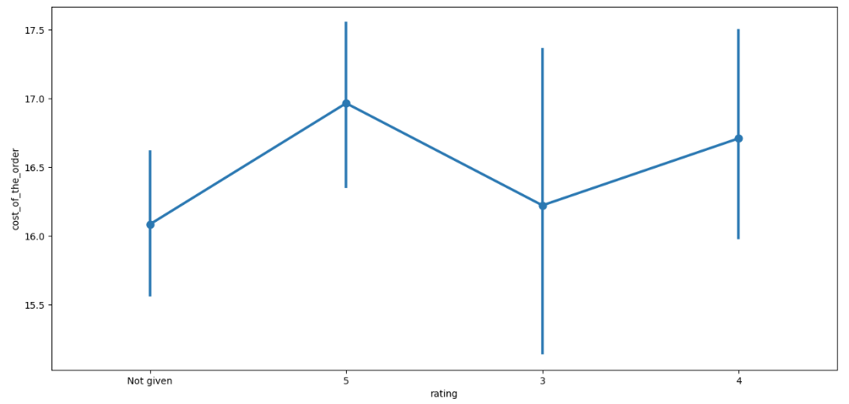
Multivariate Analysis - Rating vs Cost of the order
Higher ratings (4 and 5) are linked to slightly higher order costs, suggesting satisfied customers spend more.
Lower-rated orders tend to have slightly lower costs, but the trend is not strongly correlated.

Slide 26
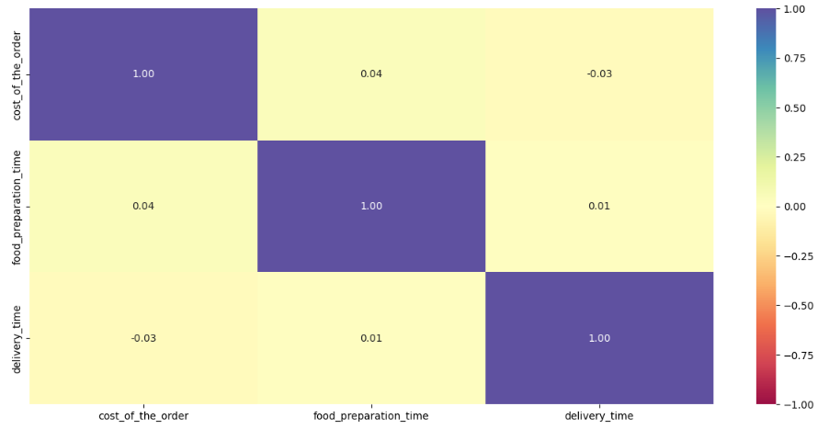
Multivariate Analysis - Correlation Among Variables
Food preparation time and order cost have highest correlation among the variables compared here.
Cost of the order has little impact on preparation or delivery time, suggesting pricing doesn’t affect speed.

Slide 27

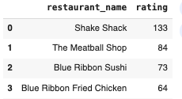
Promotional Offer for High Rating Restaurants
Offer Eligibility: More than 50 ratings of 4 or above.
Following are the five restaurants meeting above criteria and qualify for the promotional offer

Slide 28

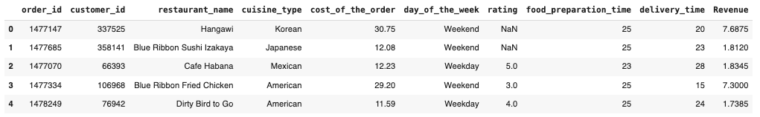
Revenue Generated by Each Restaurant
Following is the revenue generated by the first five restaurants in the data set
The total revenue earned by the company from commissions across all orders is $6,166.30. (Commission = 25% on the orders having cost greater than 20 dollars and 15% on the orders having cost greater than 5 dollars)

Slide 29
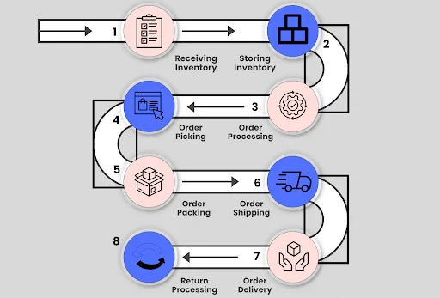
Order Fulfillment Time (Preparation + Delivery Time)
Total count of orders where fulfillment time is more than 60 minutes is 200.
Percentage of orders that take more than 60 minutes to get delivered: 10.54%
Order
Order in
system
Order
rating

Slide 30

Order Delivery Time on Day of the Week
The mean delivery time on weekdays is around 28 minutes
The mean delivery time on weekends is around 22 minutes
28
28
28
28
22
22
22

Slide 31

Key Conclusions
Cuisine Preferences and Order Costs:
American, Japanese, and Italian cuisines are the most popular.
French cuisine tend to have higher order costs, while Korean and Vietnamese cuisines
are more affordable.
Customer Satisfaction and Delivery Time:
Faster deliveries lead to higher ratings, while delayed deliveries result in lower ratings.
Weekday deliveries take longer than weekend deliveries, suggesting an opportunity to optimize weekday logistics.
Food Preparation Efficiency:
Restaurants with longer food preparation times often receive lower ratings.
Korean cuisine has the shortest prep times, making them ideal for quick service.
Revenue and Business Performance:
Shake Shack generates the highest revenue, followed by The Meatball Shop and Blue Ribbon Sushi.
The company earns over $6,166 in commission, with most revenue coming from high-value orders.

Slide 32

Business Recommendations
1: Optimize Delivery and Preparation Times:
Streamline restaurant operations for cuisines with long preparation times to improve efficiency.
Increase delivery resources on weekdays to match weekend efficiency.
2: Leverage High-Performing Restaurants:
Offer promotional deals on top revenue-generating restaurants to increase customer retention.
Encourage partnerships with high-rated restaurants to maintain customer trust.
3: Improve Customer Engagement and Ratings:
Incentivize customer reviews to increase feedback collection and improve service monitoring.
Focus on restaurants with low ratings to identify areas for improvement.
4: Revenue Growth Strategies:
Introduce premium meal bundles for high-cost cuisines to encourage larger orders.
Optimize pricing strategies to ensure competitive yet profitable order costs.

Slide 33


